Slide 1
STOP BULLYING

Slide 2
When you’re going through a stressful or difficult situation, it can clog your mind and fog your vision. This leads to people becoming distracted, stressed and unproductive. Bullying is something that affects the majority of people but alarmingly, we find that 45% of those who experience it, fail to report it through embarrassment, fear or a lack of faith in support systems. It is incredibly important that you go through the appropriate reporting channels by firstly telling a teacher/parent/guardian/learning mentor or another responsible adult. If that doesn’t work, please contact us for tailored advice. Even if you don’t want to report it, speak to somebody and don’t feel like you have to go through it alone because you don’t.
#Bullyingisneverok

Slide 3
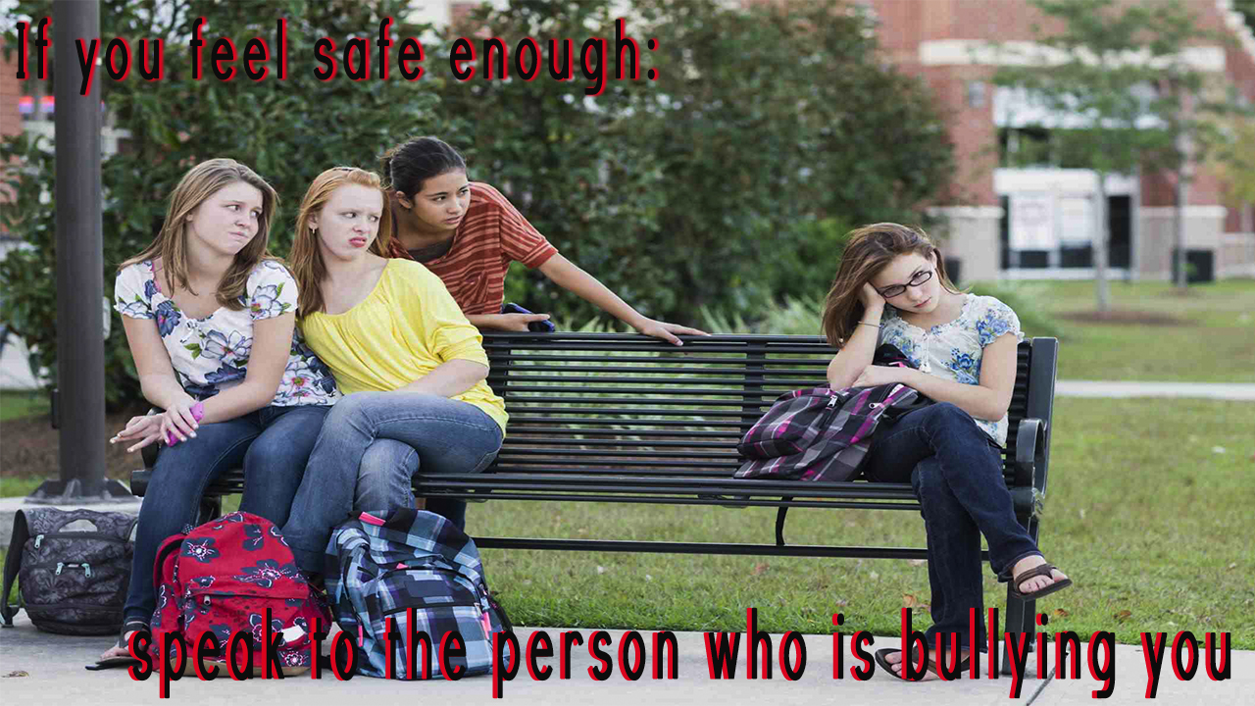
#stop bullying
Have you ever said something to a friend and upset them by accident? Chances are, it has probably happened loads of times. It’s a similar thing with bullying as the definition, by default is subjective – meaning that everybody has a different threshold of what they consider to be bullying. Sometimes, the person who is bullying you may genuinely have no idea that it is affecting you. Equally, they are probably going through a difficult time themselves and will relate to how you’re feeling. This is why we have found that speaking to the person who is bullying you can be really effective.

Slide 4
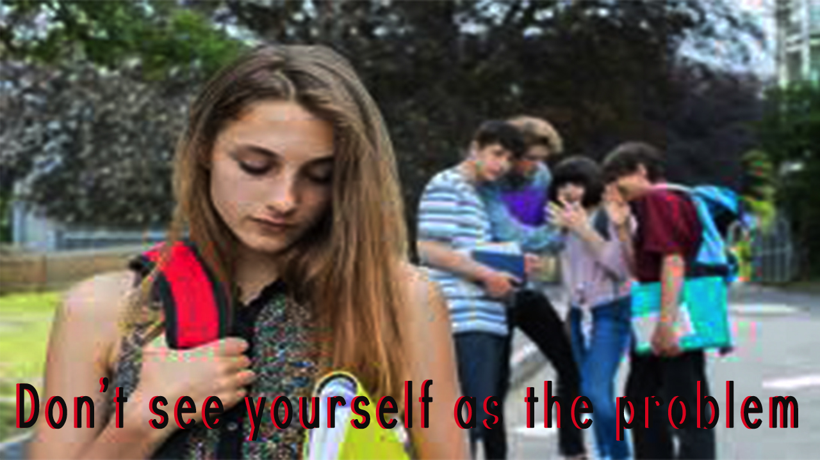
The reason people experience bullying is not because of their sexuality, gender identity, race, appearance, disability or any other unique factor; it is because of the attitude towards the factor. The only thing possible to change is attitudes. The person who is bullying you is the one with the issue, not you.

